Slide 1

MARKETING & RETAIL ANALYSIS
MRA
SALES DATA
MILESTONE1 – ABHISHEK K HIREMATH

Slide 2

Agenda
1
Executive Summary
Problem Statement
2
About data
Data Characteristics
EDA: Univariate Analysis
EDA: Bivariate Analysis
EDA: Multivariate Analysis
Summary & Insights
About RFM
What is RFM?
RFM Approach
KNIME Workflow
3
4
RFM Analysis
RFM Table & Matrix
RFM Segmentation
Top Customers in RFM Segments
RFM Recommendations
5

Slide 3
Problem Statement
The Company's Data Challenge
For the past three years, an automobile parts manufacturing company has diligently collected transaction data. However, they lack an in-house data science team to unlock its potential. They've turned to us, to leverage our expertise.
Objective:
Our objective is to :
Discover buying patterns: comprehend how customers make purchasing decisions.
Find Useful Customer Insights: insights unique to the company's operations and customer base.
Share Marketing Plans basis Customer Segments: formulate marketing strategies for distinct customer segments.

Slide 4
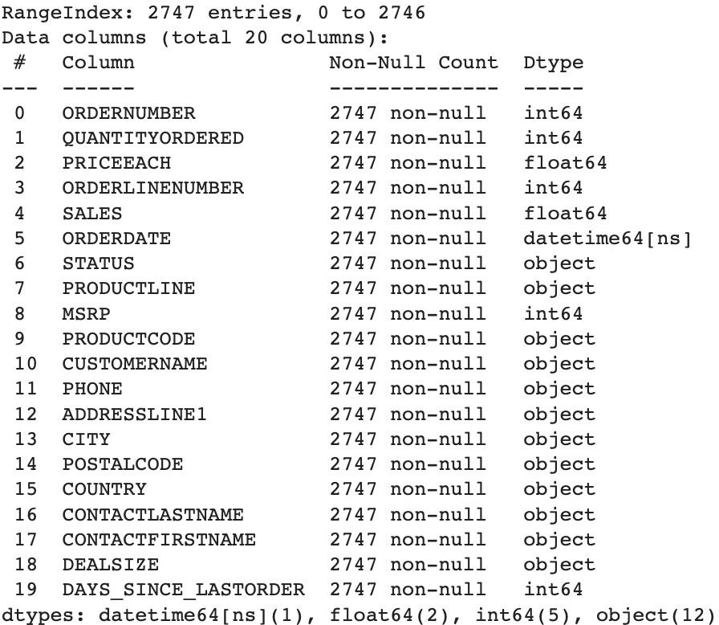
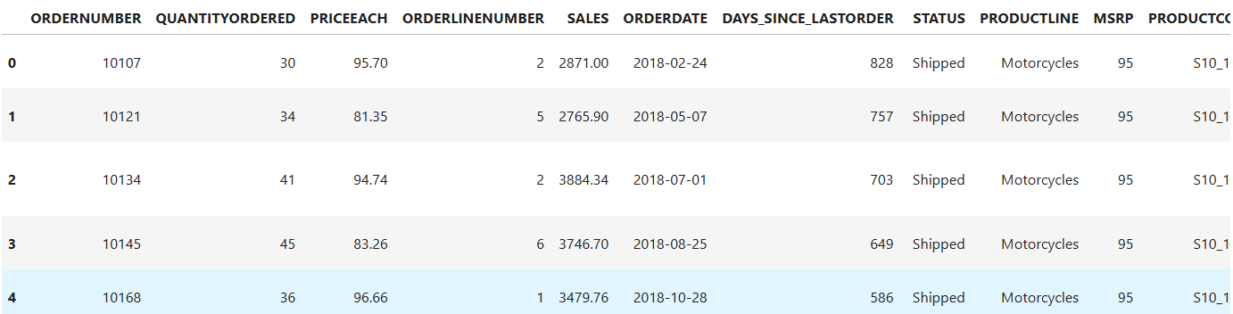
About Data : Data Characteristics
Inference:
Shape of the data: The dataset contains 2747 rows and 20 columns.
Data types : We have the columns with data type as datetime64(1), float64(2), int64(5), object(12)
No Duplicate or Missing values in the data
Key columns include sales transaction details, customer information, geographical data, product details, order status, and recency information.
Sample of dataset

Slide 5
About Data : Data Dictionary
ORDERNUMBER : Order Number
CUSTOMERNAME : customer
QUANTITYORDERED : Quantity ordered
PHONE : Phone of the customer
PRICEEACH : Price of Each item
ADDRESSLINE1 : Address of customer
ORDERLINENUMBER : order line
CITY : City of customer
SALES : Sales amount
POSTALCODE : Postal Code of customer
ORDERDATE : Order Date
COUNTRY : Country customer
DAYS_SINCE_LASTORDER : Days_ Since_Lastorder
CONTACTLASTNAME : Contact person customer
STATUS : Status of order like Shipped or not
CONTACTFIRSTNAME : Contact person customer
PRODUCTLINE : Product line – CATEGORY
DEALSIZE : Size of the deal based on Quantity and Item Price
MSRP : Manufacturer's Suggested Retail Price
PRODUCTCODE : Code of Product
Numeric columns: ORDERNUMBER, QUANTITYORDERED, PRICEEACH, ORDERLINENUMBER SALES, DAYS_SINCE_LASTORDER, MSRP.

Slide 6
Assumptions:
Each row in the data represents a unique transaction made by a customer.
The customer segments may be defined based on the purchasing frequency, amount spent, and recency of purchases (RFM Analysis).
The marketing strategies may vary for each customer segment, and the company may need to personalize their marketing efforts accordingly.
The order date and days since last order columns are accurately calculated.
The sales column is calculated as the product of quantity ordered and price each.
The status column indicates the current status of the order accurately.
The recommendations provided in the presentation are based on the insights gained from the analysis of the transaction data.

Slide 7
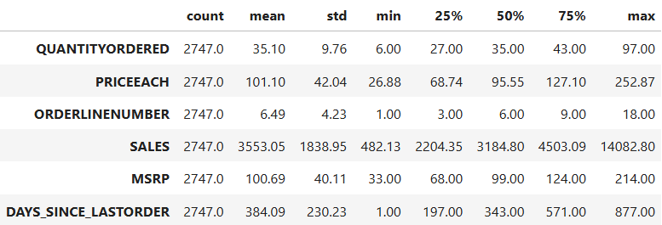
About Data : Descriptive Statistics- Numerical
Inference:
Sales: The average sales per transaction is approximately $3,553.05. Customers make purchases ranging from $482.13' to $14,082.80. The data is skewed with presence of outliers on right tail
Quantity Ordered: On average, customers order approximately 35 items per transaction, with a minimum of 6 and a maximum of 97 items. Data is slightly skewed towards right.
Price Each: The average price of each item in an order is approximately 101.10 Prices vary between a minimum of 26.88 and a maximum of 252.87. The data is skewed with presence of outliers on right tail
Manufacturer's Suggested Retail Price (MSRP): The average MSRP is approximately 384.09, with prices ranging from 33 to 214. Data is slightly skewed towards right.

Slide 8
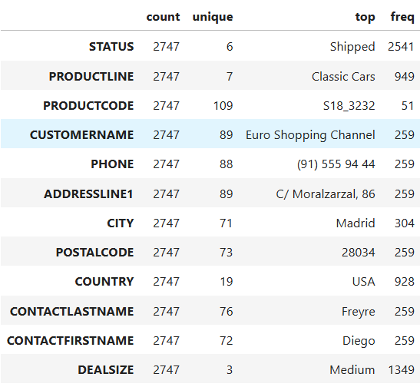
About Data : Descriptive Statistics - Categorical
Inference:
Order Status: The most common order status is "Shipped," occurring 2541 times.
Product Line: "Classic Cars" is the dominant product line with 949 entries.
Customer Concentration: "Euro Shopping Channel" is the top customer, with 259 transactions.
Geographic Trends: "Madrid" and "USA" are the most frequent city and country, respectively.
Deal Sizes: The majority of deals fall into the "Medium" category, accounting for 1349 cases.

Slide 9
About Data : Assumptions & Modification in data
Data Modifications :-
In the raw data, DAYS_SINCE_LASTORDER is taken as 2022-06-07 for the difference, we will be removing it & creating new Days difference baseline as 01-06-2020 (1st June 2020)
For Exploratory Analysis, we have created below features:
Year
Month
Week
Quarter
SALES (K) : Custom sales feature with scaling of 1000s
Profit : Difference between Manufacturer's Suggested Retail Price (MSRP) and PRICEEACH
New temporary data frames creates for the Categorical & Numerical features, and below features were excluded in it: ‘ORDERNUMBER’, PHONE','ADDRESSLINE1', 'CONTACTLASTNAME',' CONTACTFIRSTNAME as these have no relevance in the data

Slide 10
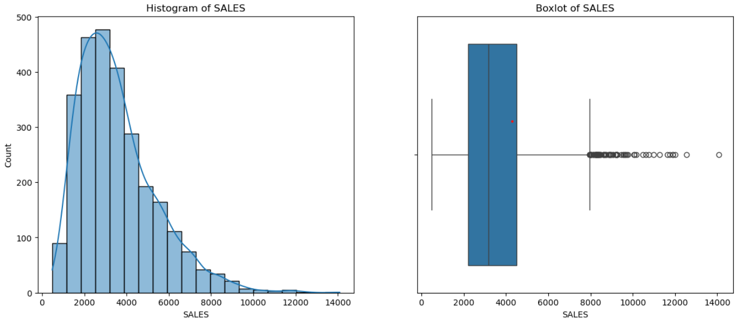
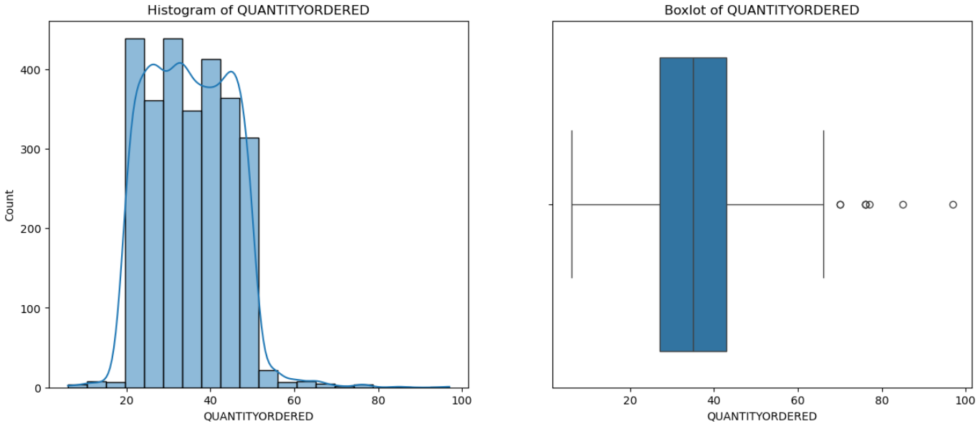
Univariate Analysis - Sales
Inference:
Total 2,747 sales transactions having total sales of $9.76M
The average sales amount is approximately $3,553.05 and with a standard deviation of about $1,838.95
The data is highly skewed with presence of outliers on right tail
Inference:
Average quantities ordered - 35.10
Range: From 6 to 97, showing a span of 91 units.
Most ordered quantities are between 20-50

Slide 11
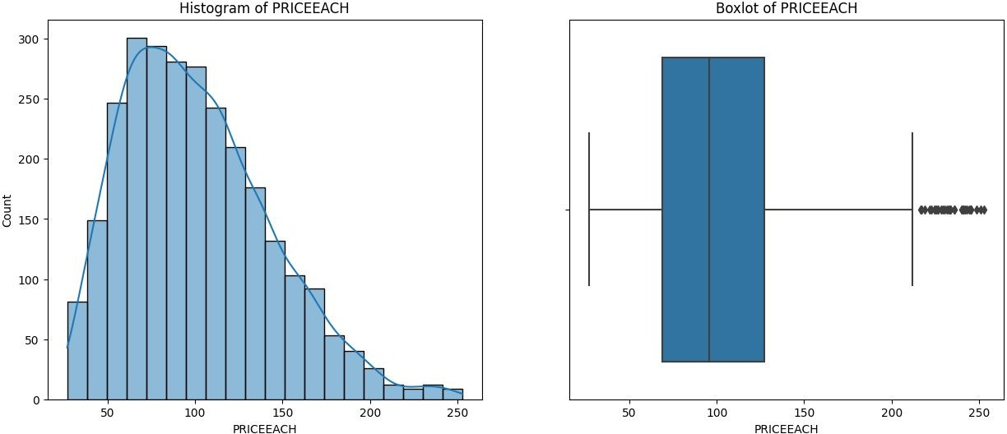
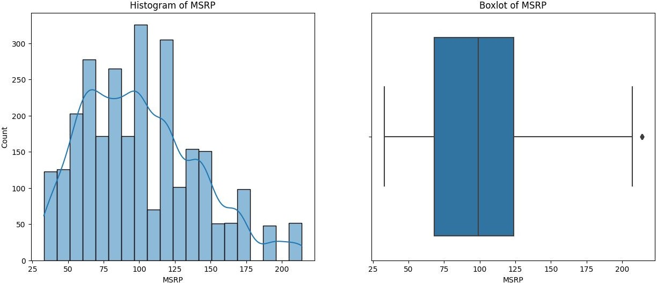
Univariate Analysis - Price & MSRP
Inference:
Selling Price
Average MSRP: $101.10
Price Range: vary widely, ranging from $26.88 to $252.87
Distribution: The 25th %tile is $68.75, median is $95.55,, and the 75th %tile is $127.10.
Skewed towards right.
MSRP(Manufacturer Suggested Selling Price)
Average MSRP: $100.69,
Price Range: vary widely, ranging from $33 to $214
Distribution: The 25th %tile is $68, median is $99, and the 75th %tile is $124.

Slide 12
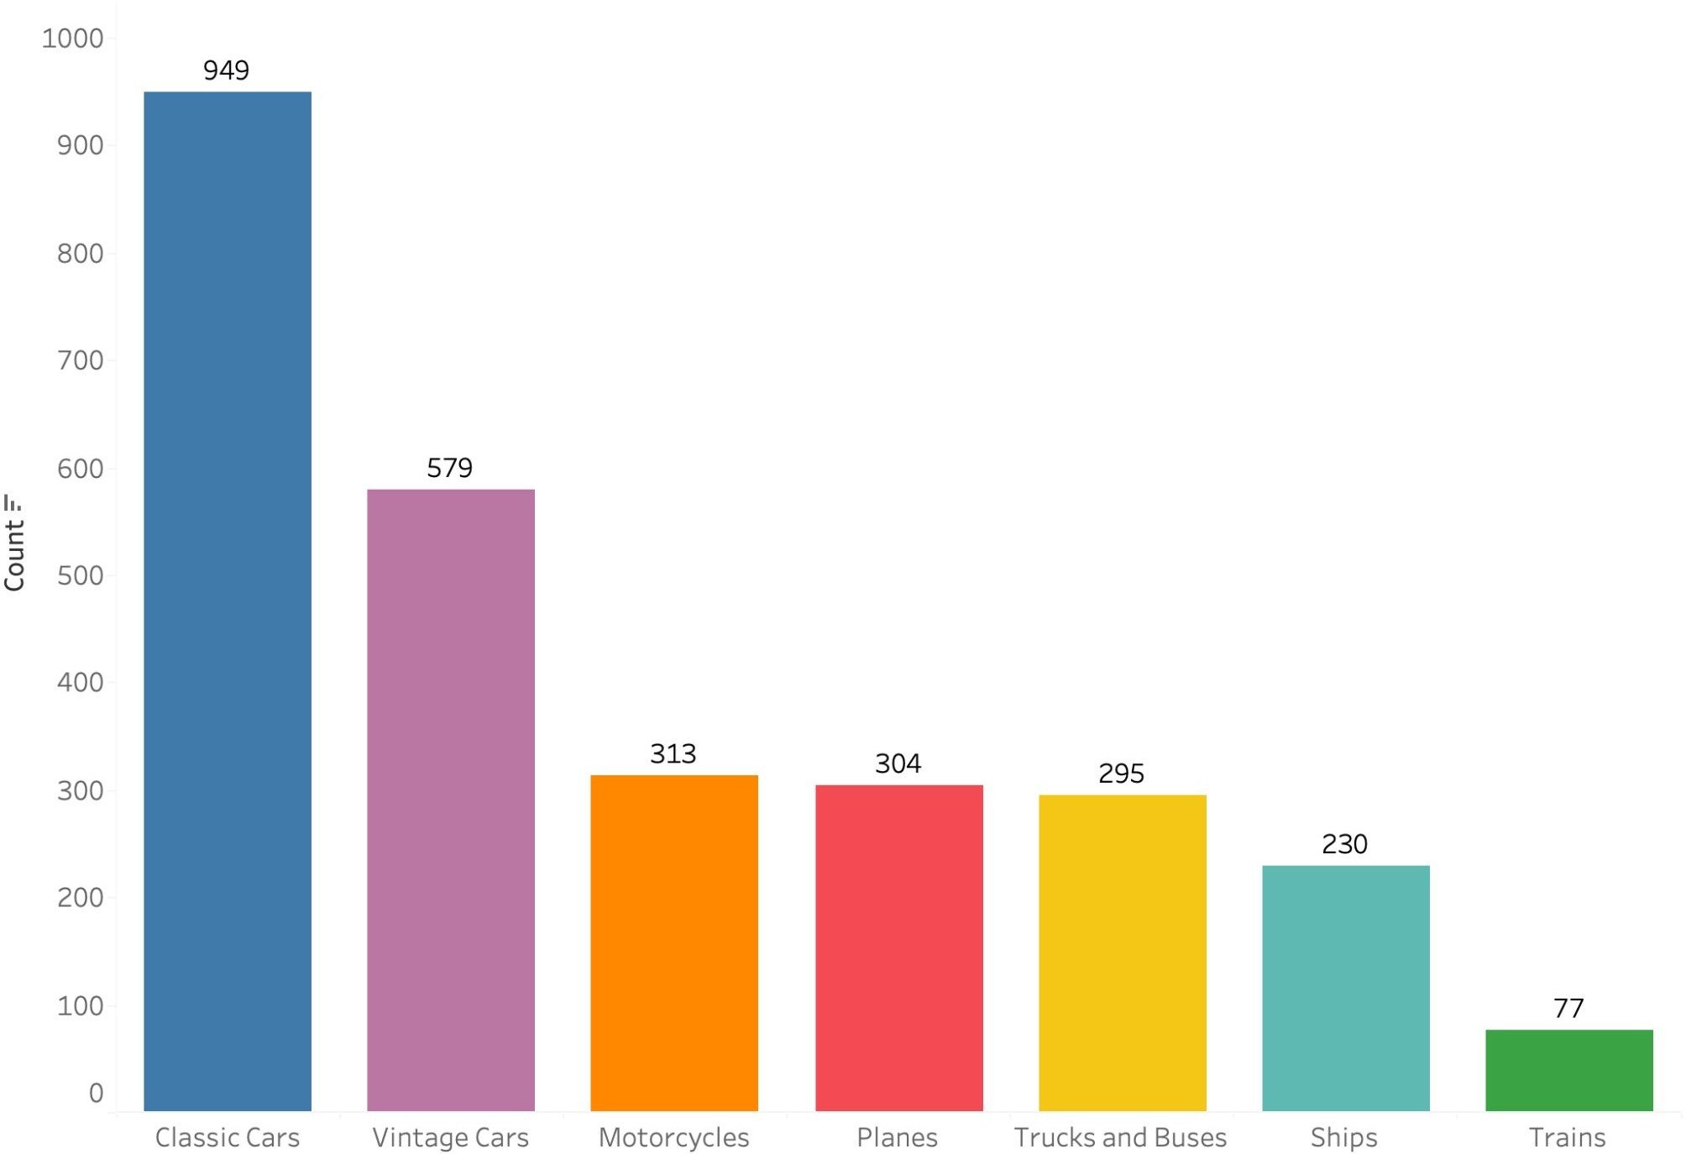
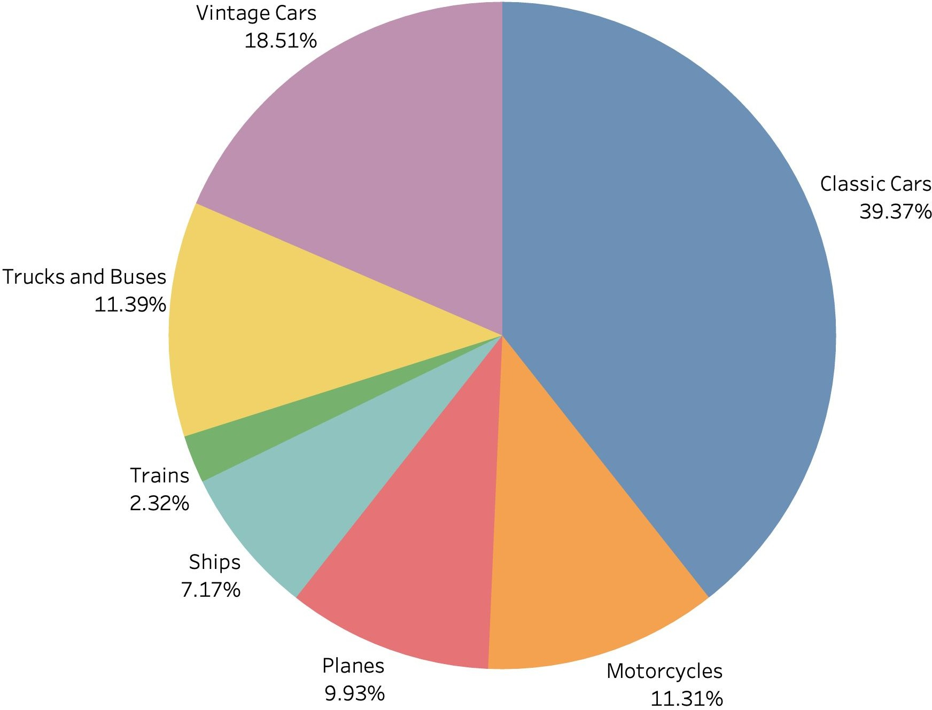
Univariate Analysis - Product Line
Inference:
Total 7 product lines.
Most sold parts are of Classic & Vintage automobiles having a share of approx. 57.9%
Train parts are sold the least (7.2%)

Slide 13
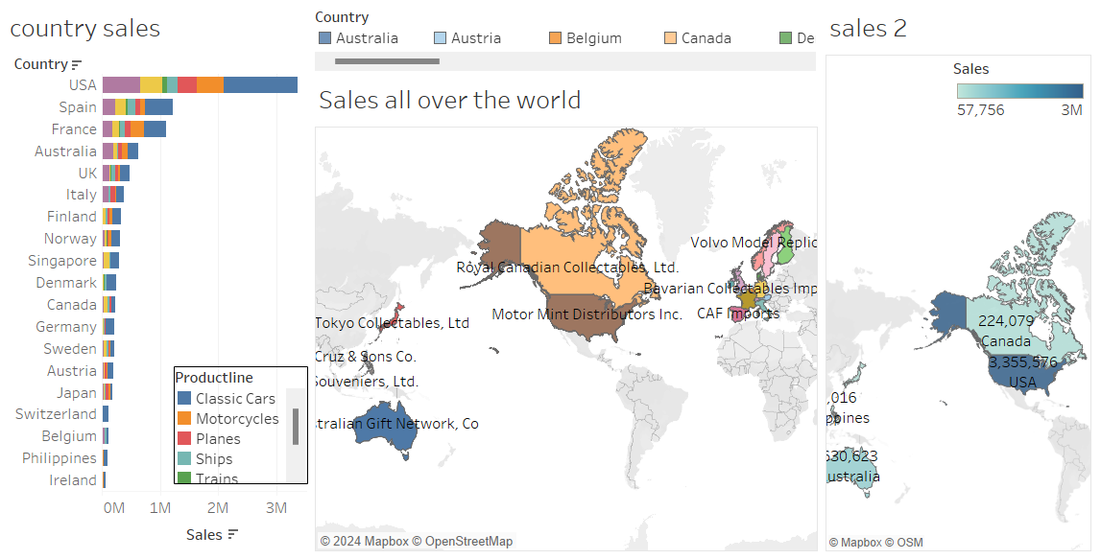
Geographical Overview of Sales - Country
Inference:
Top 5 countries with Highest Sales value are USA, Spain, France, Australia and UK.
Highest Sales are from USA i.e. $3.36M,
while Lowest sales are from Ireland i.e
$57.7K

Slide 14
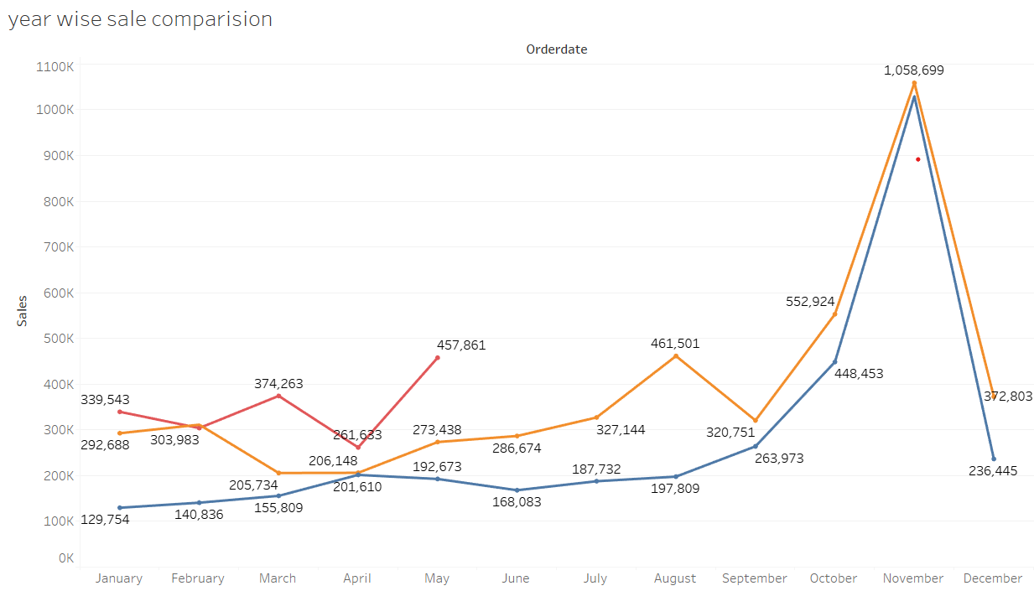
Sales Over Time: YOY Monthly Sales Trend
Inference:
Highest sales are in Nov. every year
This Sales Trend indicates Seasonality
Sales in 2020 are comparatively higher than the rest 2 years shows upward Trend.

Slide 15
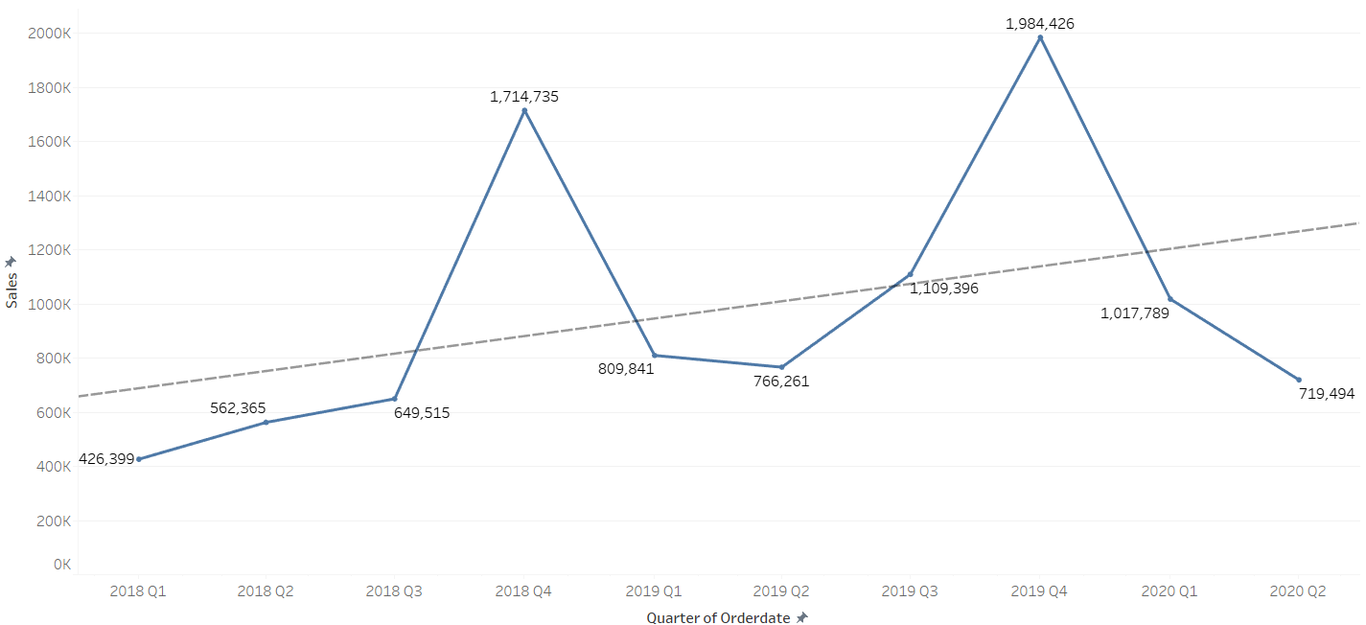
Sales Over Time: Quarterly Sales Trend
Inference:
Highest sales are in Quarter 4
This Sales Trend indicates Seasonality
Post reaching highest in Q4, sales drops in Q1 & starts going up after Q2 (Except 2020)
Overall sales Trend is upward

Slide 16
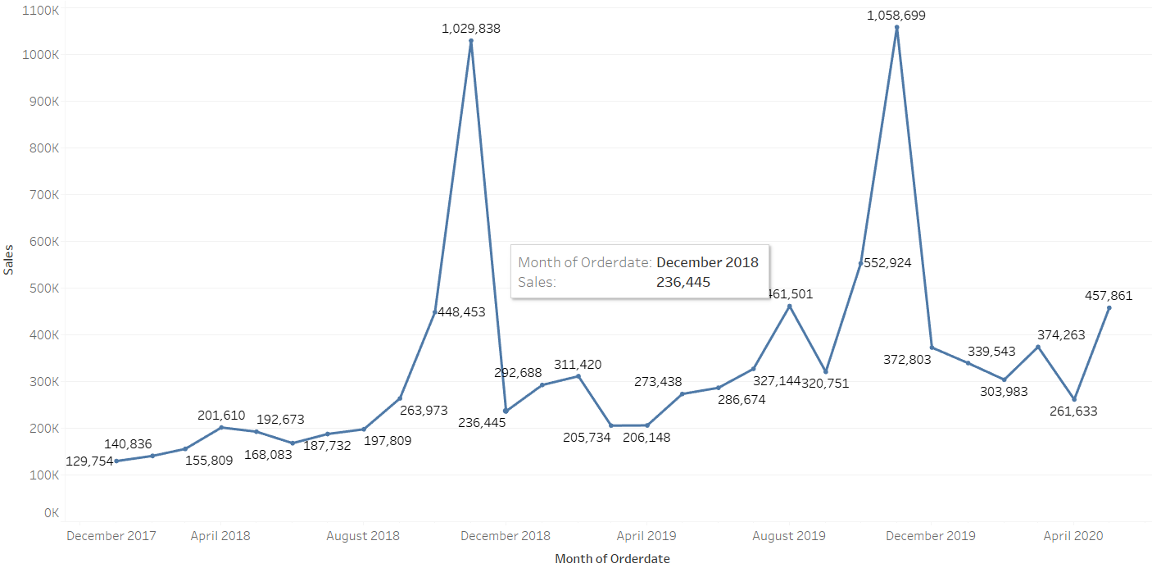
Sales Over Time: Monthly Sales Trend
Inference:
Highest sales are in Nov. every year.
Sales goes up in Sept. till Nov.
This Sales Trend indicates Seasonality
Overall sales Trend is upward

Slide 17
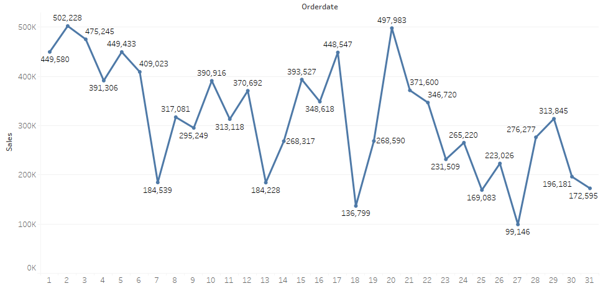
Sales Over Time: Day Sales Trend
In the stating days of month there is more sales as compared to the end days.
Inference:
The sales are generally highest at the start of the month and trend decreases towards the end with spikes in mid.
On Weekdays, the sales decreases while highest on weekend.
In the stating days of month there is more sales as compared to the end days.

Slide 18
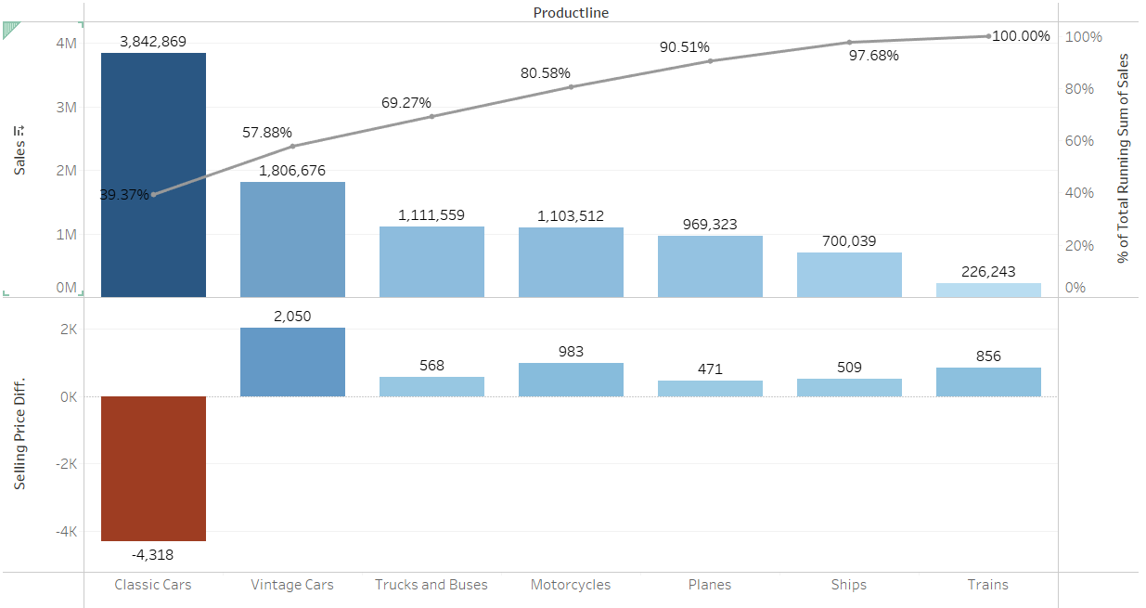
Product Line & Sales
Inference:
Most Sales are from Classic car parts i.e. ~39.4%.
Car, Truck, Bus & Motorcycle parts accounts for 80% of the company’s revenue.
Train parts generates the least revenue.
While Classic cars has Highest Sales, it also has the Least Selling price difference in negative( MSRP - Actual selling price)

Slide 19
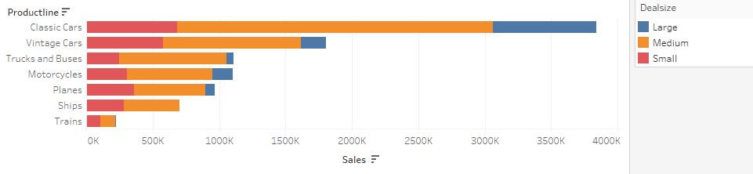
Sales & Deal Size
Most sales: Classic cars
Least sales: Trains
Most Deal size: medium
Least Deal size: large
Sales of truck and buses and motorcycle are approx. same

Slide 20
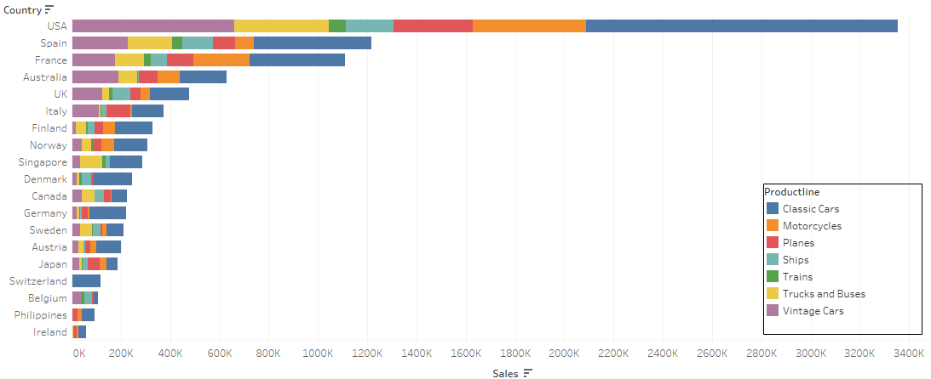
Country, Product line, Sales
Highest sales : USA
Least sales: Ireland
Switzerland deals with Only classic car parts.

Slide 21
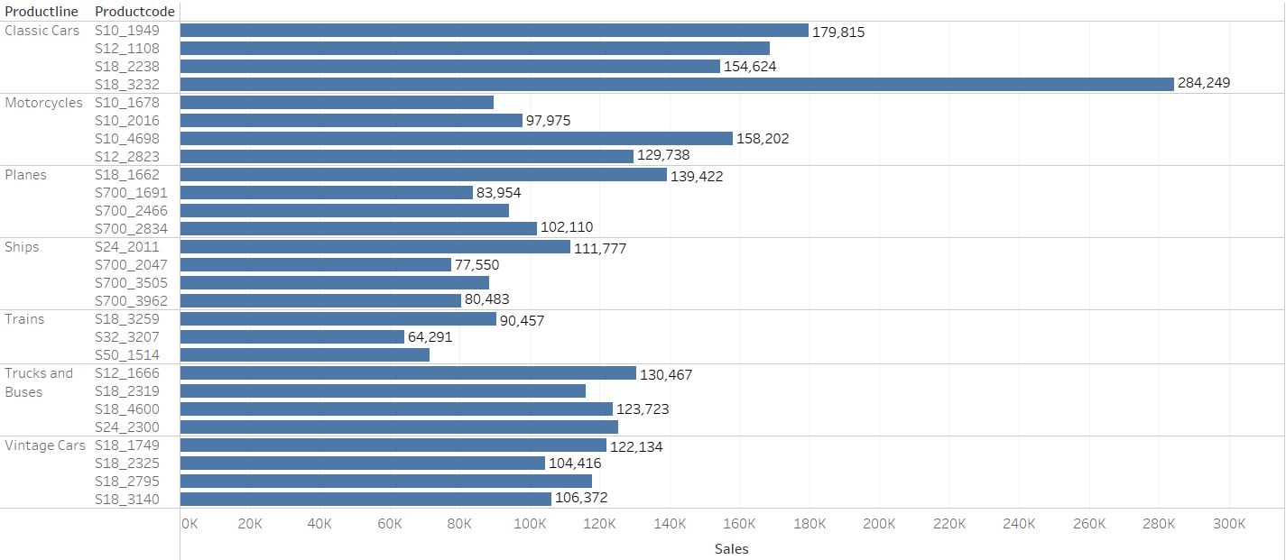
Product Line & Sales : Top Products
Insights
S18_3232 is the most selling item across all Product Lines & Classic car parts.

Slide 22
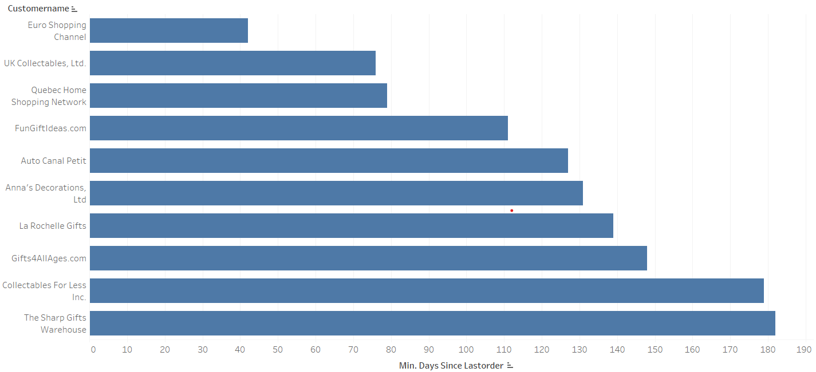
Top Customers : Recency
Inference:
The most recent customers are: Euro Shopping Channel, UK Collectables, Ltd., Quebec Home Shopping Network.

Slide 23
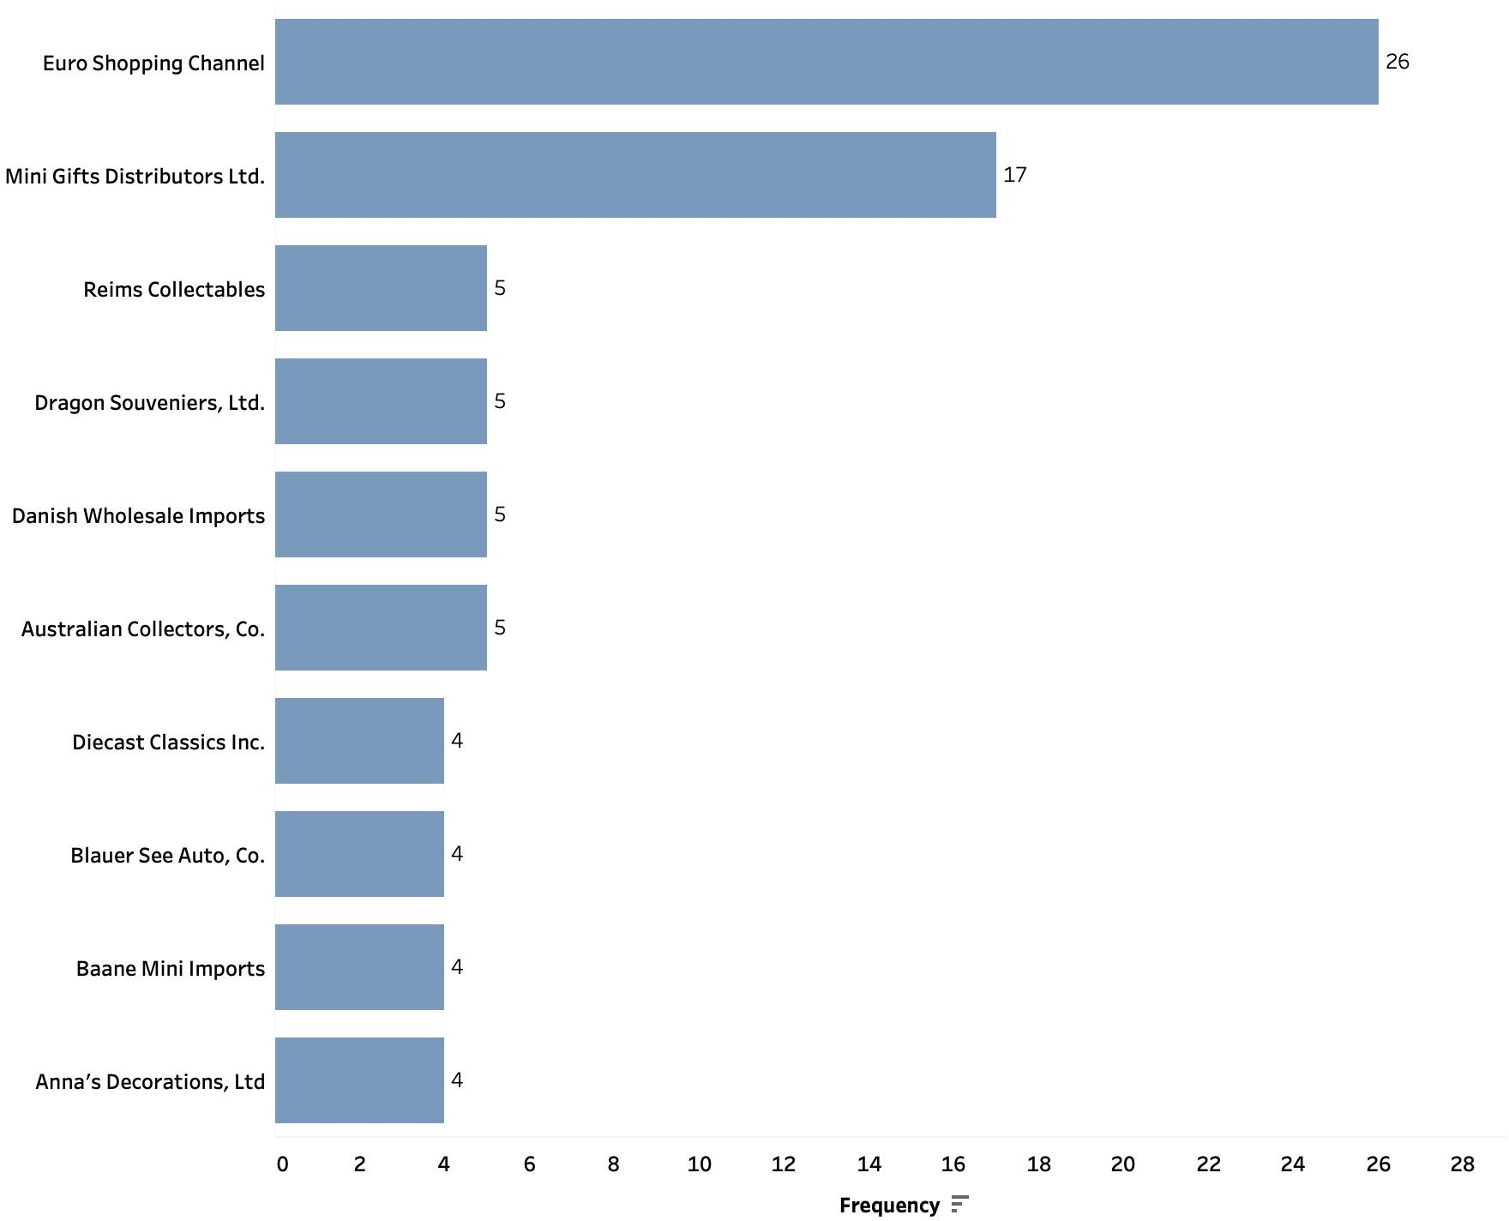
Top Customers : Frequency
Inference:
The most recent customers are : Euro Shopping Channel & Mini Gifts Distributors Ltd.

Slide 24
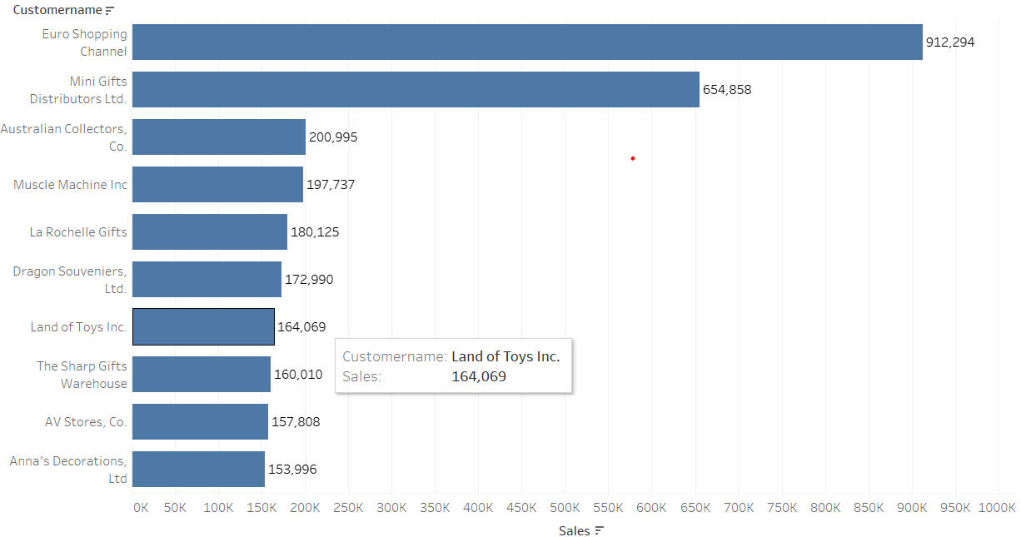
Top Customers : Monetary
Inference:
The most recent customers are : Euro Shopping Channel & Mini Gifts Distributors Ltd.
The above customers were most recent & frequent as well, indicating them as the most valuable customers for the brand

Slide 25
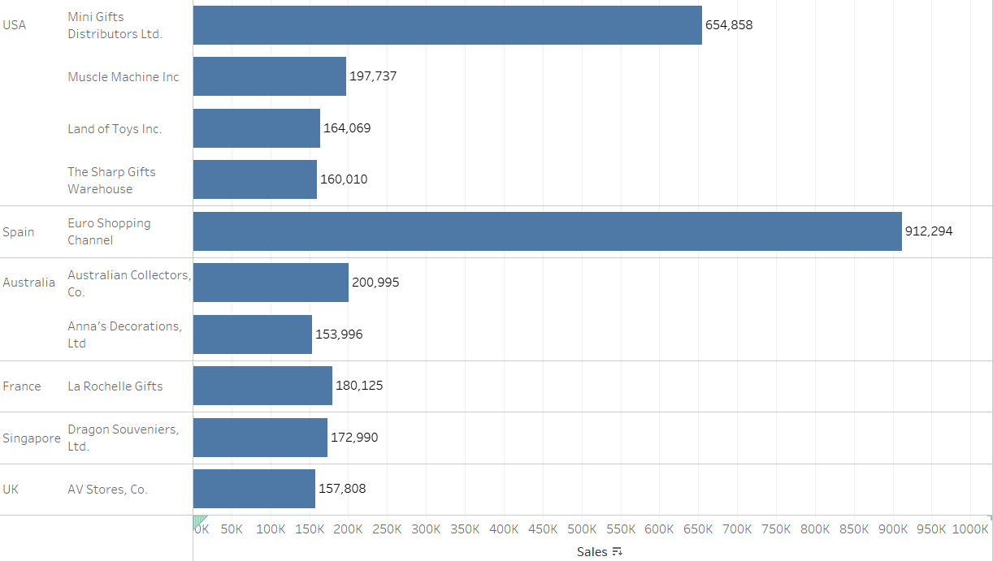
Top 10 Customers distribution across Countries
Inference:
Most of the customers belongs to USA
Euro Shopping Channel is the most spending Customer across all countries as well as Spain. It contributes over 80% of the sales from Spain.

Slide 26
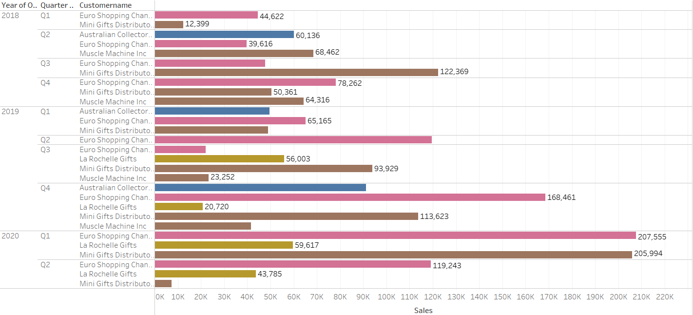
Top Customers : Year & Quarter
Inference:
Sales in Q1 of 2020 are comparatively higher than rest of the quarters.
Highest Contribution to sales in most quarters are from Euro Shopping channel & Mini Gifts distributors Ltd.

Slide 27
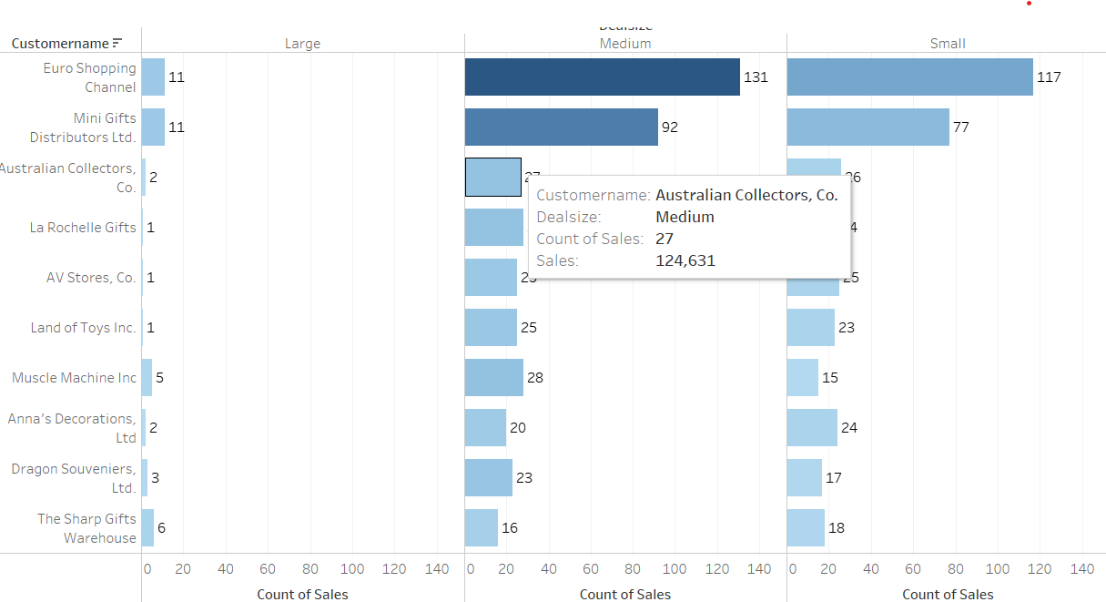
Top Customers by Deal Size
Inference:
The Top customer Euro Shopping channel & Mini Gifts distributors Ltd has majority of medium followed by Small Deals

Slide 28
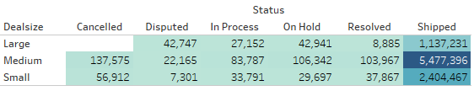
Status, Sales and Deal Size
Inference:
No order of large deal type is cancelled it’s a good sign.
Most shipped parts belong to medium deal size type.

Slide 29
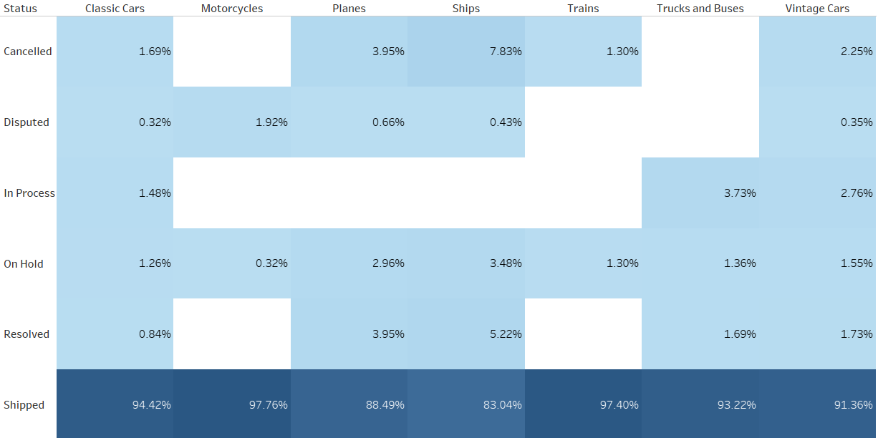
Product Live & Status
Inference:
Most of the orders in each Product Line are currently in shipping status.
Ships has the highest cancellation rate of 8% among all
Motorcycles, Truck & Buses parts have no cancellations at all.

Slide 30
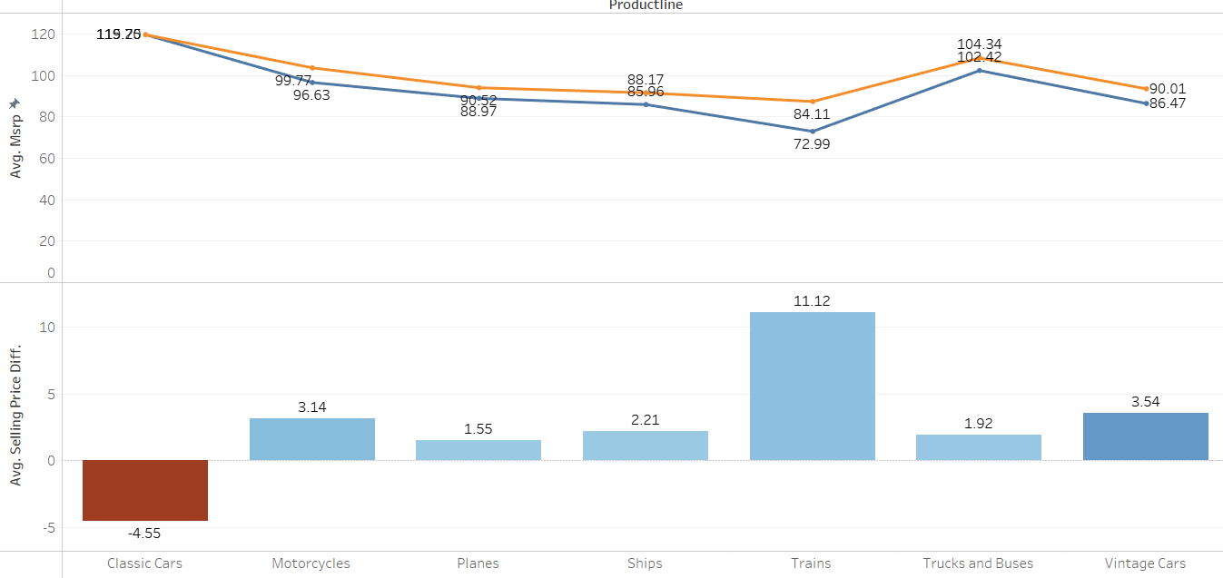
Selling Price vs Suggested - Product Line
Inference:
The average of Selling price & suggested price is between -4.55, indicating sold on lower price than suggested to +11.12 indicates sold at higher price.
Classic cars have the highest difference in negative, while trains have the highest difference in positive

Slide 31
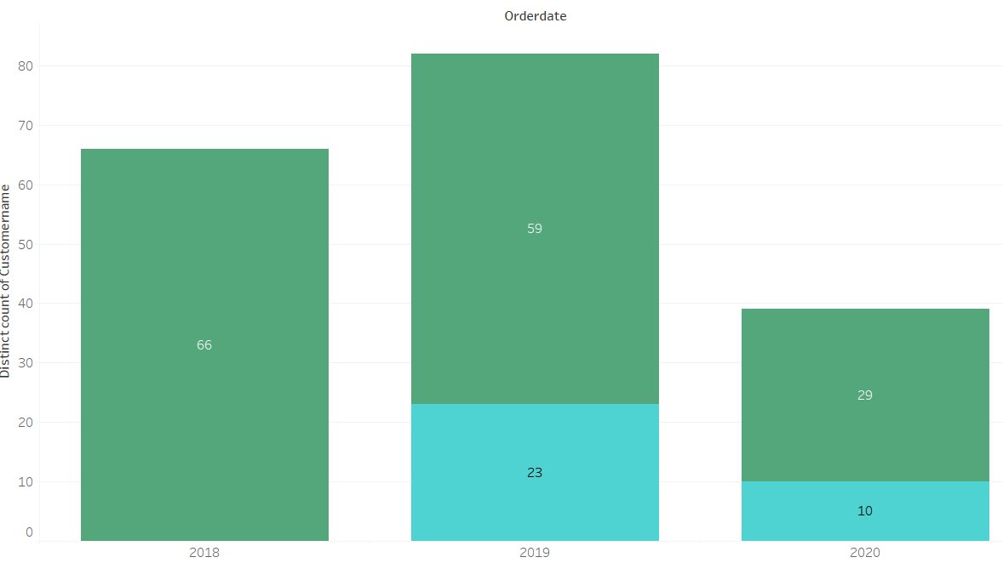
New Customer Acquisition & Retention
Inference:
No new customers acquired in 2020.
Only 23 new customers acquired in 2019.
90% customers of 2018 were retained in 2019.

Slide 32
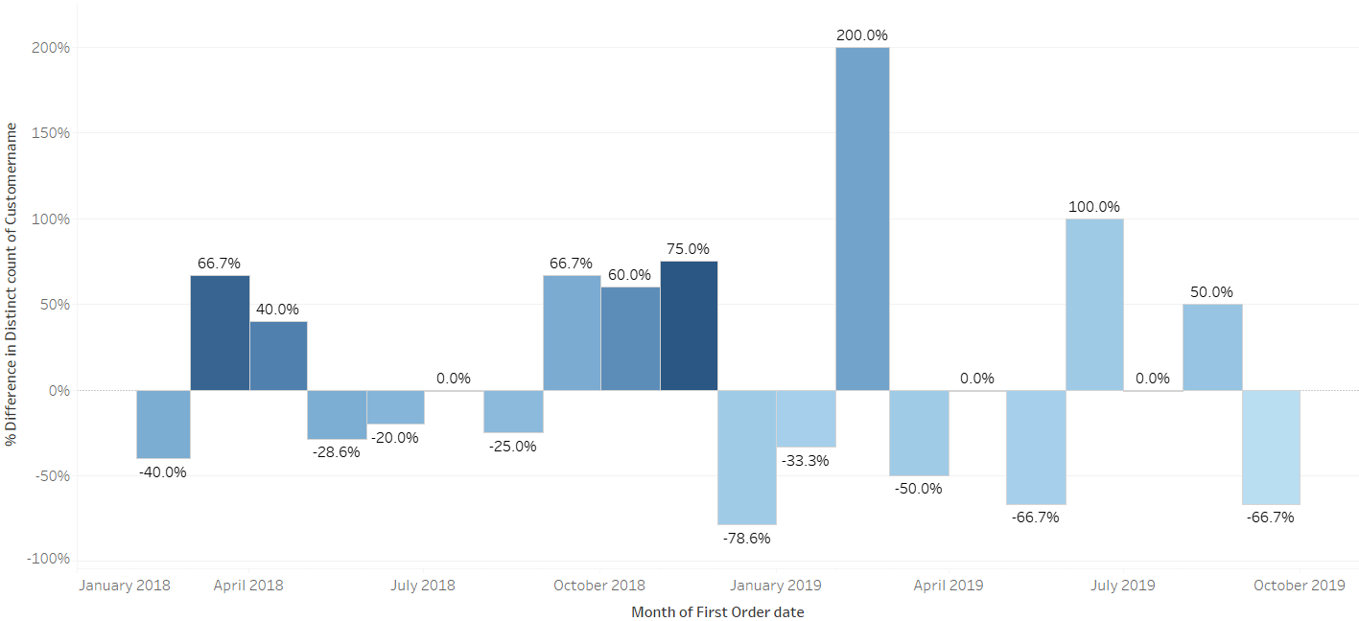
New Customer Growth Rate
Inference:
Highest growth rate in new customers was seen in between Jan & Apr’2019
Between Oct 2018 - Jan 2019 saw the least new customer growth.
No new customers acquired post Sept 2019.

Slide 33

Dashboard : Sales

Slide 34
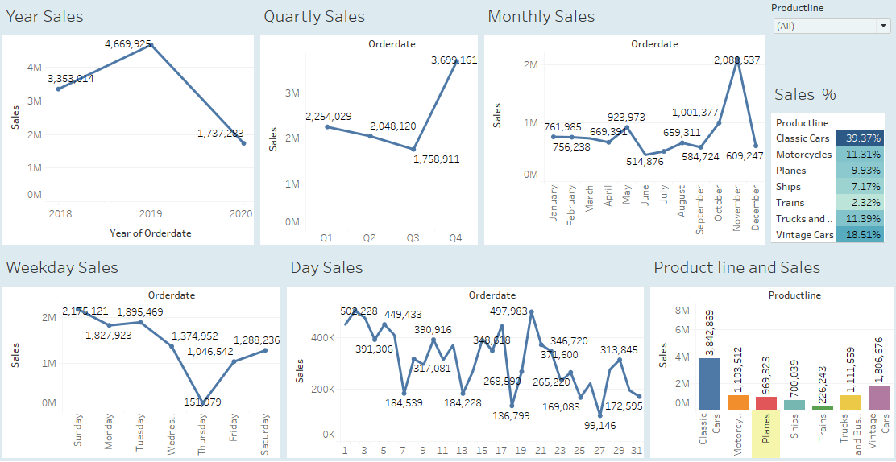

Slide 35
Key Insights
Sales Overview:
298 orders placed by 89 customers from 19 countries in the last 2.5 years.
United States leads in sales, followed by Spain and France. Notable sales from Australia and Singapore in the Eastern Hemisphere.
Among cities, Madrid tops sales, with San Rafel and New York City following.
In the Eastern Hemisphere, sales from Australia and Singapore declined, while customers from Japan were added in 2019.
Significant sales increase observed in US and France in 2019.
Product and Revenue:
The company manufactures 109 automobile parts under 7 product lines with prices ranging from 26 to 252.
Classic Car parts generate the maximum revenue through sales (approx. 40%).
Car, Truck, Bus, and Motorcycle parts account for 80% of the company's revenue.

Slide 36
Key Insights
Sales Trends:
Upward sales trend with monthly seasonality. Peak sales in October and November annually.
Higher sales and customer activity in the early months of 2020 compared to previous years.
Concern: No new customers added since September 2019.
Transaction Characteristics:
Most deals are of medium and small size, with transactions typically containing 20 to 50 items.
Key Customers:
Euro Shopping Channel and Mini Gifts Distribution Ltd. are best customers (highest spending, most frequent, and recent).
Customer Retention:
A good customer retention rate of approximately 90% was observed in 2019.

Slide 37

ABOUT RFM

Slide 38
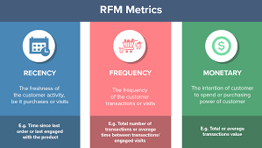
What is RFM?
The RFM analysis model enables the business to categorize customers using
three criteria derived from a customer's transaction history, specifically:
Benefits of RFM Analysis
Personalization: By creating effective customer segments, you can create relevant, personalized offers.
Improve Conversion Rates: Personalized offers will yield higher conversion rates because your customers are engaging with products they care about.
Improve unit economics
Increase revenue and profits
How recently the user made purchase
How frequently the user purchase
Ho much do they spend

Slide 39

Tool used : KNIME
KNIME, the Konstanz Information Miner, is a free and open-source data analytics, reporting and integration platform.

Slide 40
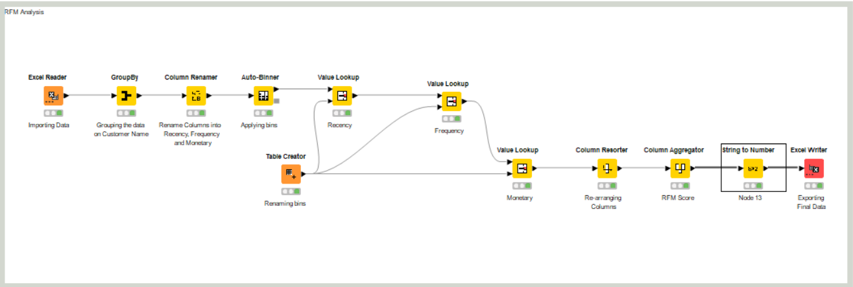
RFM Analysis - KNIME Workflow
Note:
The data is preprocessed in Python along with Date Difference. No preprocessing or EDA done here
The data id binned in 4 buckets 1,2,3 & 4 for Recency, Frequency & Monetary.
RFM Score: 4 being the best & 1 being the lowest score

Slide 41
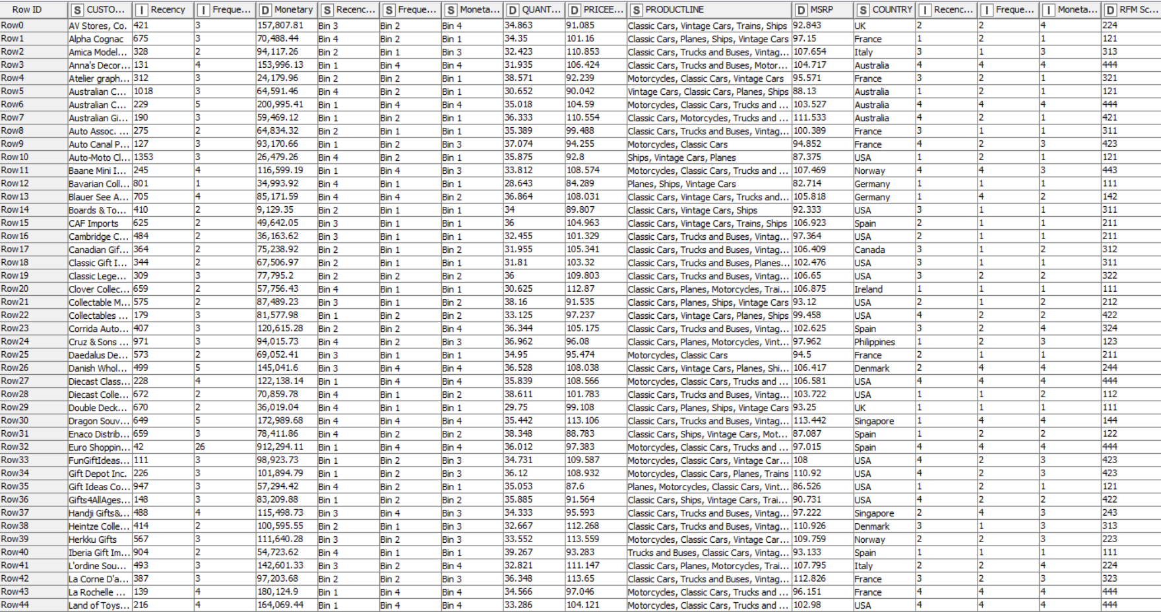
RFM Analysis - KNIME Output Sample

Slide 42

RFM Analysis Segmentation

Slide 43
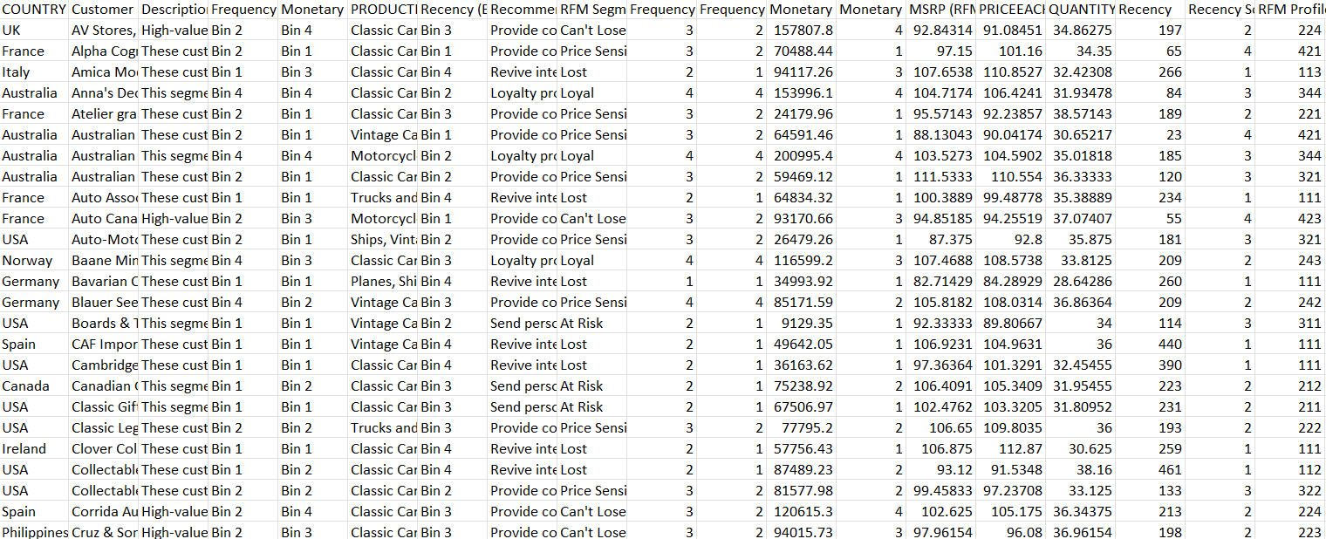
RFM : Sample of Customer List

Slide 44
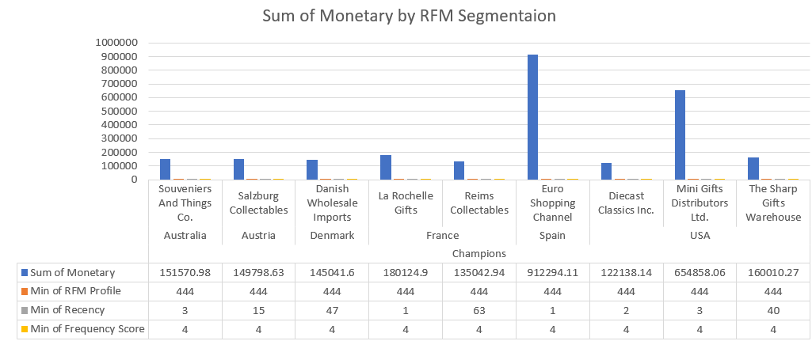
RFM - Best Customers - Champions
Customers having a perfect 4-4-4 score
Total 9 customers are segmented as Best customers
They Bought most recently, Buys most frequently, and buys big.
Create positive WOM (word of mouth)
Recommendation:
Loyalty programs, new product and value-added recommendations based on past purchase

Slide 45
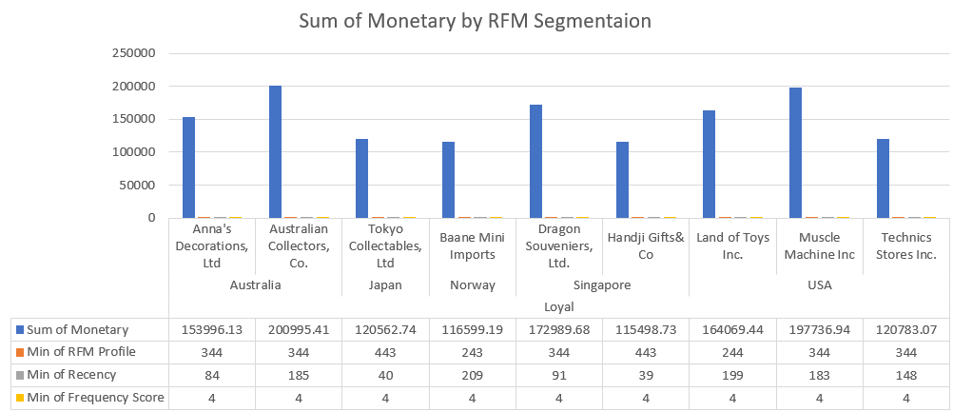
RFM - Loyal Customers
Recent, most frequent and spends High.
Total 9 customers are segmented as Loyal customers
Clear and positive view of the brand.
Happy with the product and service provided, and are unlikely to switch to alternatives.
Important to make these customers feel valued
Recommendation
Offer Loyalty programs, ask for reviews, reward (e.g., Free Shipping) and Engage them.

Slide 46
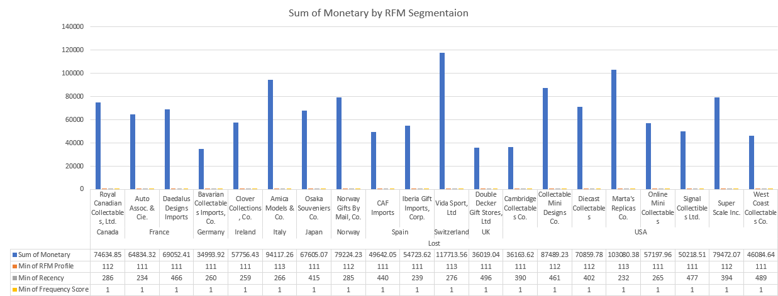
RFM - Lost Customers
Inactive since a while, lowest frequent and low spends ( 11X)
Total 20 customers are segmented as Lost
We can say Stopped using services altogether
Very difficult to re-engage with this segment, as they either have a negative view of the service or a more trustworthy alternative.
Most customers are from USA(9)
Recommendation
Revive interest with reach out campaign ignore otherwise

Slide 47
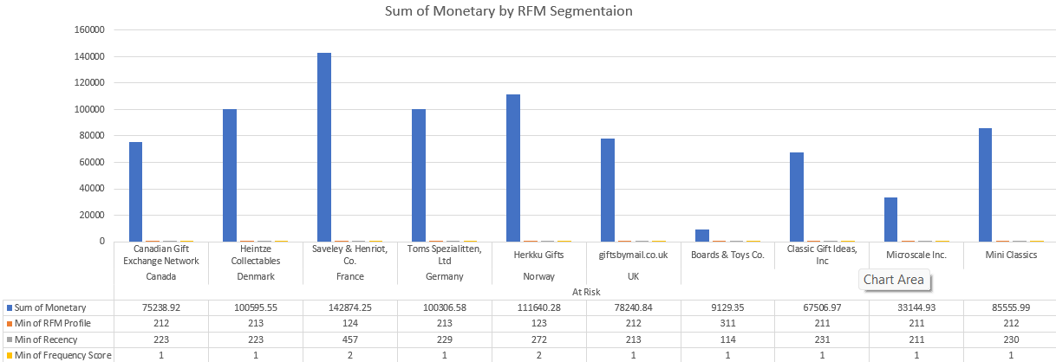
RFM - At Risk Customers- On The Verge of Churning
Relatively less active since a while, low frequent and average spends
Total 10 customers are segmented as At Risk
Considering stopping use of the service due to various reasons.
Might had bad experience with services. In order to prevent this, it's necessary to scrutinize their behavior.
Recommendation
Send personalized emails to reconnect
Improve trust & loyalty. Offer renewals, provide helpful resources.

Slide 48

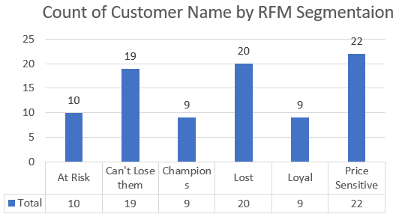
Recommendations
According to RFM analysis, customers can be categorized into Six distinct groups: Champion, loyal, Price Sensitive, Can’t Lose Them, At Risk and lost customers. It is important to develop a focused approach for each group in order to optimize customer retention and enhance customer experience.
best customers(Champions), it is recommended to provide personalized recognition, exclusive offers, and incentives to ensure that they continue to choose our company over others. By doing so, we can maintain their loyalty and strengthen the long-term relationship.
loyal customers(Loyal & Price Sensitive), it is essential to offer periodic discounts and offers to keep them engaged by providing cost effective deals and tailored offers and interested in our products or services. By keeping them engaged, we can turn them into our best customers and improve their satisfaction level with our brand.
verge of churn customer(At Risk & Can’t Lose Them), we need to develop an effective action plan to prevent them from leaving the company. We can conduct surveys, offer incentives, and personalize the communication to identify and address their concerns, and thereby increase their loyalty towards our brand.
lost customers, it is important to analyze their behavior and preferences to identify the reasons for their departure. By identifying the key drivers of customer churn, we can develop targeted strategies to prevent such occurrences in the future and improve our overall retention rate.

Slide 49
Thank You

